Slide 1
Housing Initiative
Team: Sharks
Team Members: Mohana, Supriya, Varun, Kevin

Slide 2
ABSTRACT
Housing is an age-old problem that continues to forever haunt society, and for postsecondary educational institutions, it is no different. These institutions create their own miniature societies, and although they provide their own housing services, these services are often faced with significant overhead and limitations due to a variety of factors. The goal of the Sparta project is to tackle these limitations. We aim to provide a fully integrated housing solutions platform for these institutions so that they can focus more on the actual services that they provide to their students. We hope that by consolidating everything into one easy to manage platform, the actual services will improve, which will help improve not just the quality of student residential life, but also the housing problem in society.

Slide 3
OBJECTIVE
Our main objective is to make the users to find housing easy with the desired features of a house including all the information of available houses and also it helps in agents of housing to post the vacancies in a easier way and can also update them regularly based on the needs.
This also helps for the users to compare the different available options and choose the suitable one.

Slide 4
TECHNOLOGIES
Frontend: React.js
DataBase: Mongodb
Backend: Node.js
Security: JWT
Tools: VS Code, GitHub

Slide 5
FUNCTIONALITIES
Register and Login
User/Admin Details
Editing the information of Agent
Posting available Accomodation
Updating and Deleting the posted Accomodations
Displaying available Accomodations
Uploading the house images using Firebase
Searching for accommodations and filtering based on desired features

Slide 6
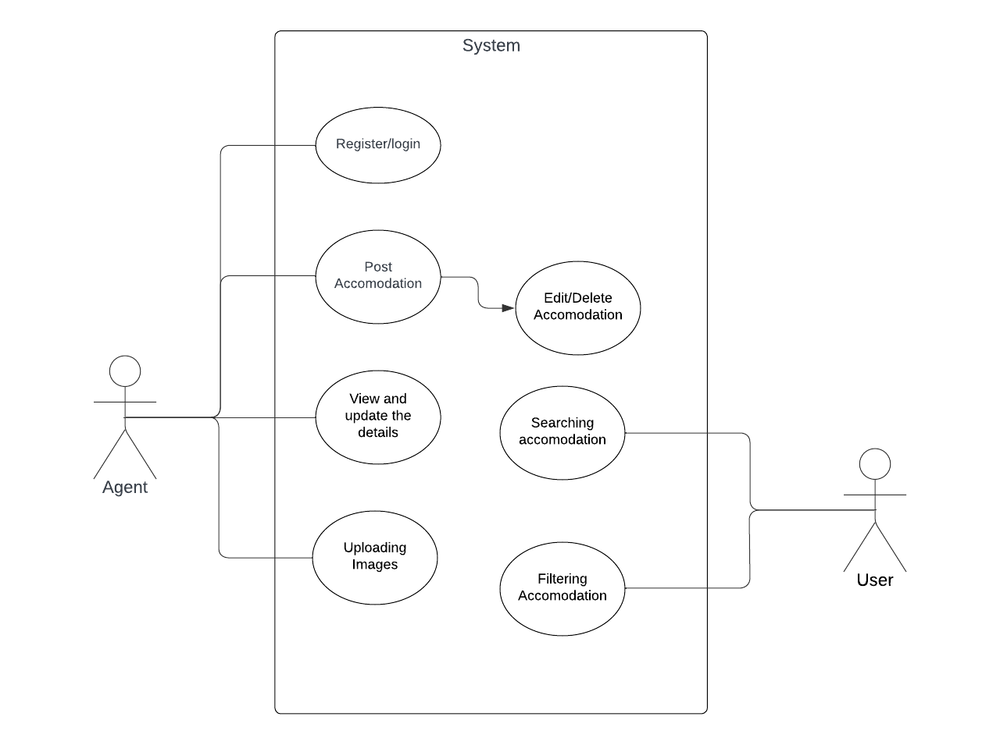
USE CASE DIAGRAM
The use case diagram is shown with agent and user as actors

Slide 7
DEMO
Right Place to find an Accomodation !!

Slide 8
FUTURE GOALS
To deploy it using AWS EC2 Server
To add an chat option so that the users can chat between them to share each other opinions on their own findings
To display the nearest available grocery markets for every housing option.

Slide 9
THANK YOU !!
Finally You are going to find right accommodation with user friendly interface.

